Slide 1








SUPERSTORE SALES

Slide 2


AGENDA
01
Introduction
02
Relation Diagram
03
Cleaning
04
Q&A
05
Visualization
06
Recommendations
07
Conclusion

Slide 3

This project focuses on cleaning raw data and preparing it for analysis using Excel, Python, and SQL, followed by building clear dashboards to present key insights. The workflow includes fixing inconsistencies, handling missing values, standardizing formats, and validating accuracy to ensure high-quality data. After cleaning, we analyze the dataset to answer key business questions and create an interactive dashboard that helps stakeholders explore metrics and make informed decisions.
INTRODUCTION

Slide 4
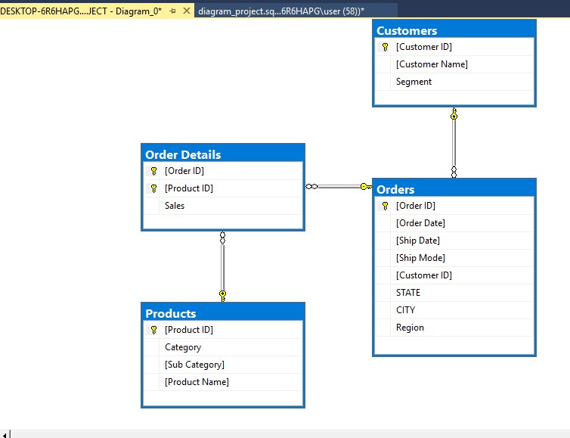
RELATION DIAGRAM
RELATIONAL DATABASE STRUCTURE OVERVIEW
This ER diagram shows the key tables in the dataset Customers, Orders, Order Details, and Products and how they are connected through primary and foreign keys.
During data cleaning, duplicates were removed, missing values handled, and data types standardized to ensure accuracy and integrity.
These relationships form the backbone for analysis and dashboard creation, allowing us to track sales performance, customer behavior, product categories, and order lifecycle across different regions.

Slide 5

CLEANING

Slide 6
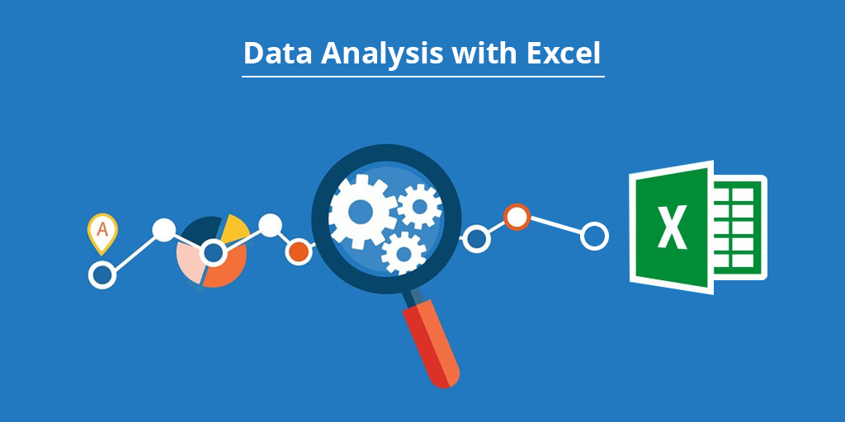


CLEANING
Used Excel to perform initial data cleaning, including removing duplicates, fixing formatting issues, correcting typos, handling missing values, and standardizing date and text fields. This ensured a clean baseline before deeper processing.
Used Python (Pandas) to automate advanced cleaning tasks such as detecting outliers, normalizing column types, merging large datasets, validating values, and applying rule-based corrections. This step improved consistency and reduced manual errors.
Used SQL to enforce referential integrity, validate relationships between tables, remove invalid records, standardize keys, and ensure the final dataset is reliable and analysis-ready. SQL also handled transformations needed for building accurate dashboards.

Slide 7

PYTHON CLEANING
Using Python, the raw dataset was transformed into a clean, structured, and analysis-ready format.
The process included handling missing values, removing duplicates, standardizing formats, correcting inconsistencies, and reshaping the data for deeper analysis.
This stage ensures that every insight generated later is accurate, trustworthy, and based on high quality data.

Slide 8
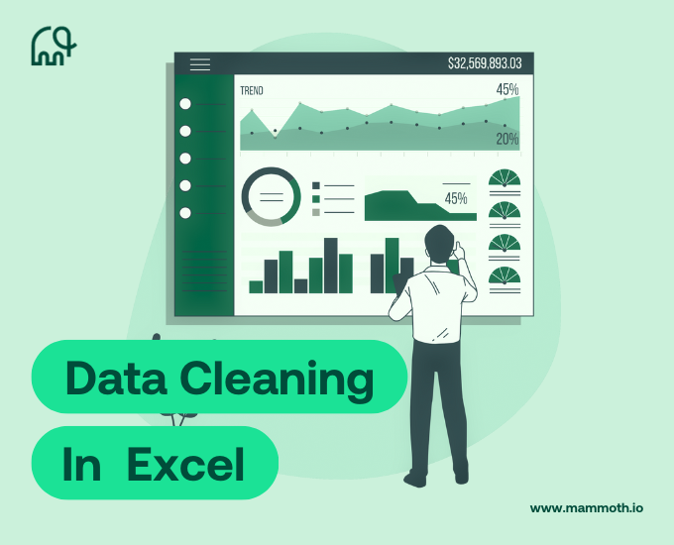
EXCEL CLEANING
In Excel, the dataset was cleaned and structured to ensure clarity and usability.
Tasks included removing duplicates, fixing inconsistent entries, applying data validation, unifying date and number formats, and organizing the dataset into a logical, easy-to-navigate layout.
This stage ensures a solid foundation for analysis and smooth integration with other tools.

Slide 9

SQL CLEANING
Using SQL, the data was imported, structured, and optimized for efficient querying.
Cleaning steps included resolving null values, normalizing tables, enforcing primary and foreign keys, and writing queries to identify and fix inconsistencies across the dataset.
The result is a well-organized, relational database that supports fast, accurate, and scalable analysis.

Slide 10
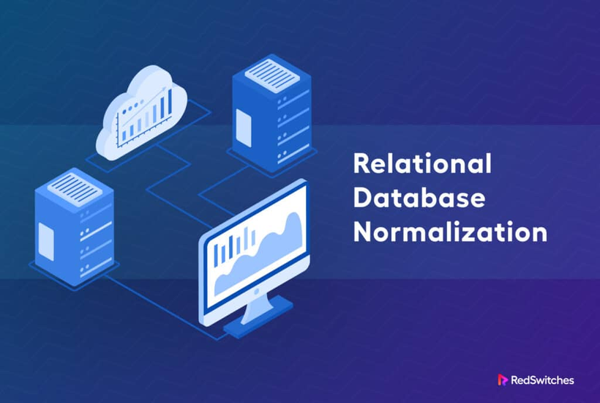
NORMALIZATION
As part of the normalization phase, the dataset was first cleaned to remove duplicates, fix inconsistencies, and validate key fields. After that, the data was reorganized into four normalized tables Orders, Customers, Products, and Order_Details to reduce redundancy and ensure a clear relational structure. Primary and foreign keys were assigned to maintain referential integrity and support efficient analysis.

Slide 11
Q&A

Slide 12


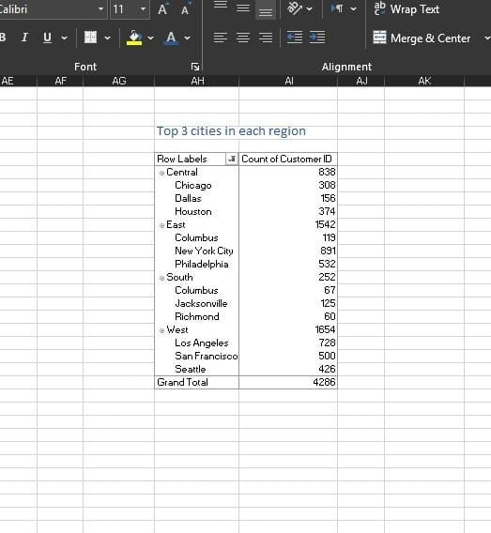
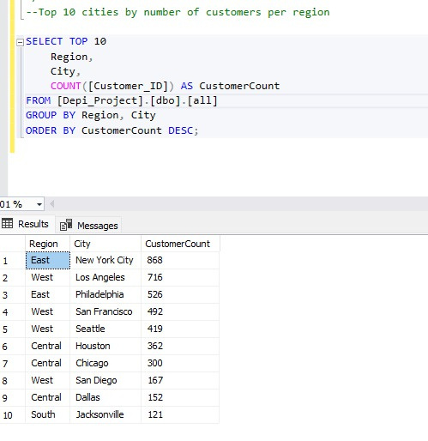
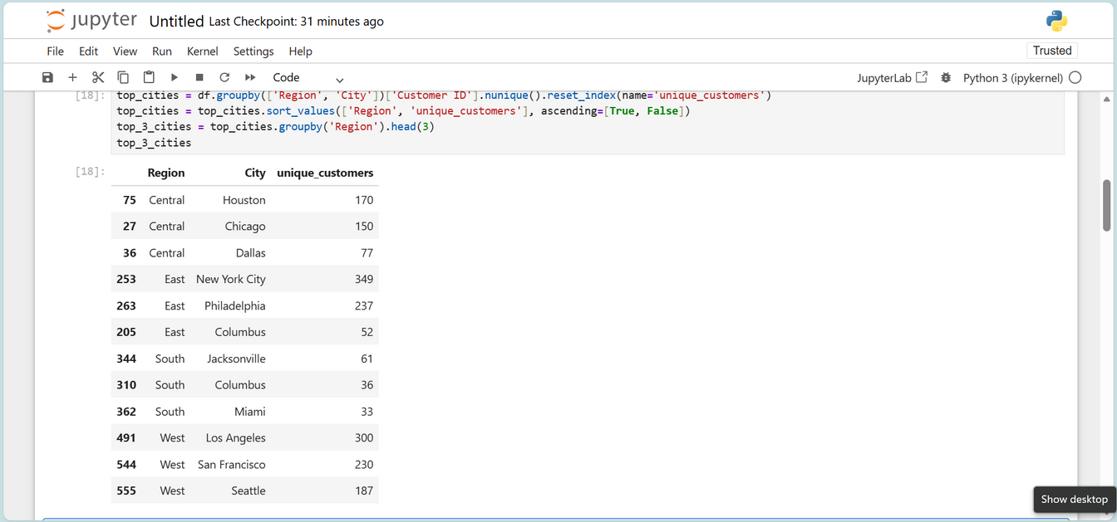
Q1- TOP 3 CITIES IN EACH REGION
EXCEL ANSWER
SQL ANSWER
PYTHON ANSWER

Slide 13
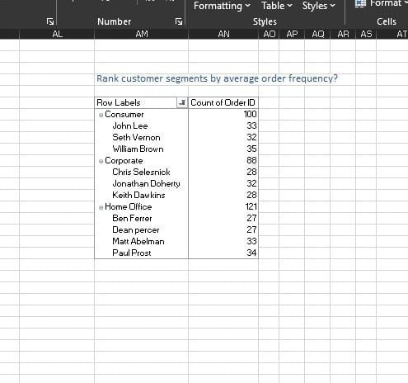
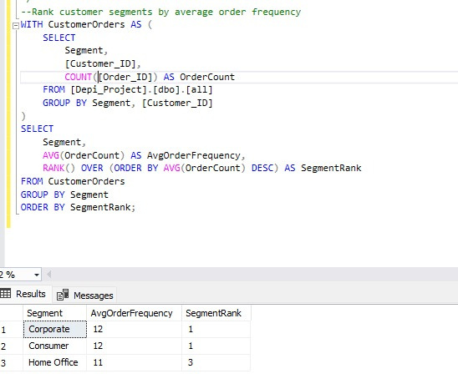
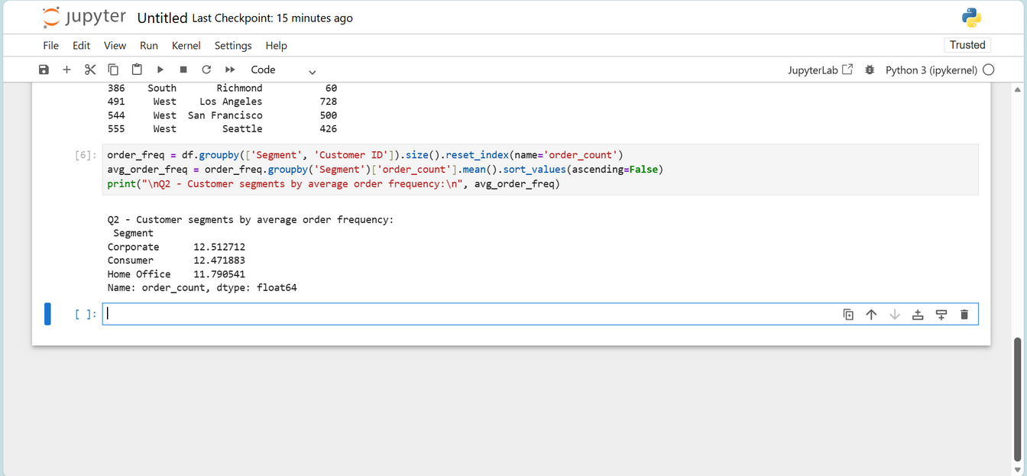
Q2-RANK CUSTOMER SEGMENTS BY AVERAGE ORDER FREQUENCY
EXCEL ANSWER
SQL ANSWER
PYTHON ANSWER

Slide 14
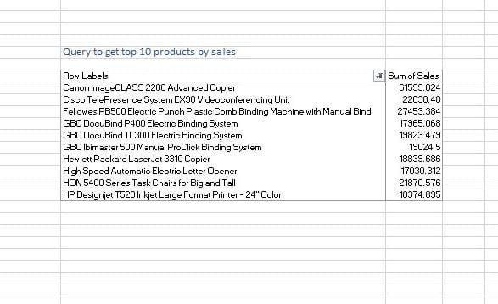
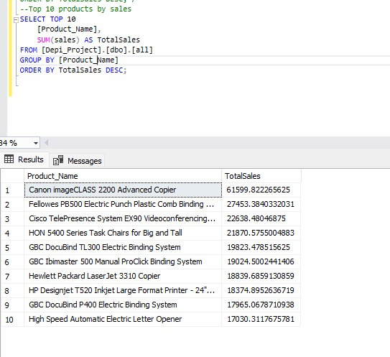
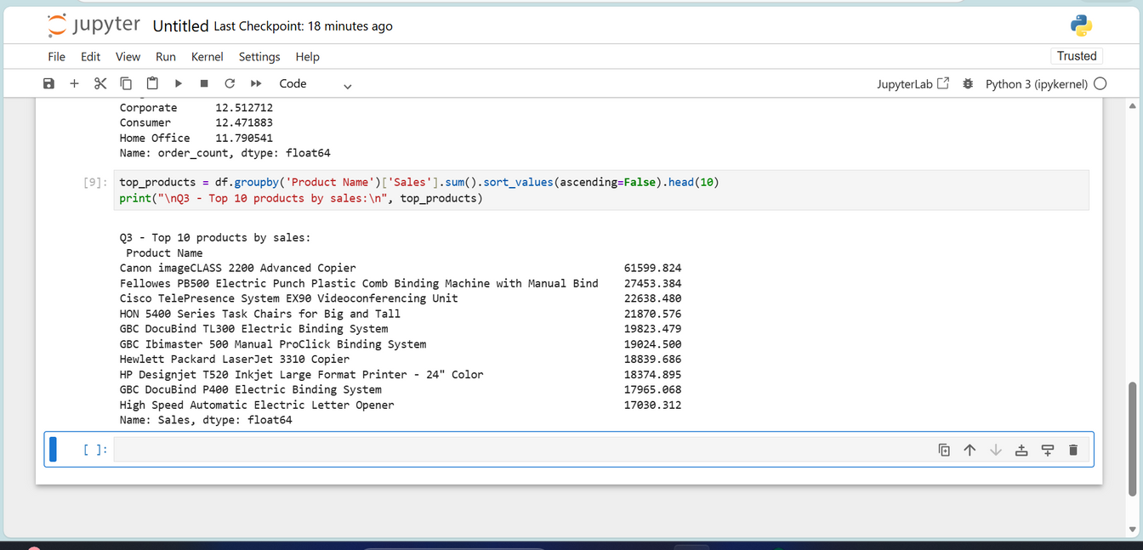
Q3- TOP 10 PRODUCTS BY SALES
EXCEL ANSWER
SQL ANSWER
PYTHON ANSWER

Slide 15
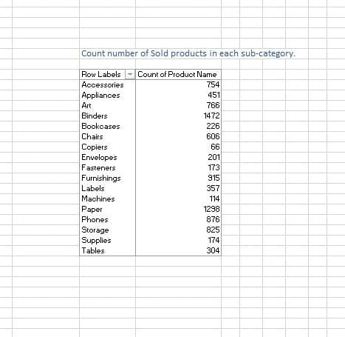
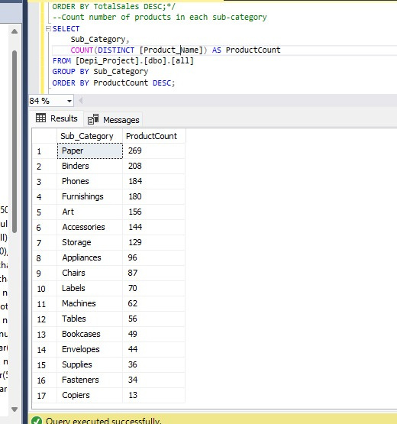
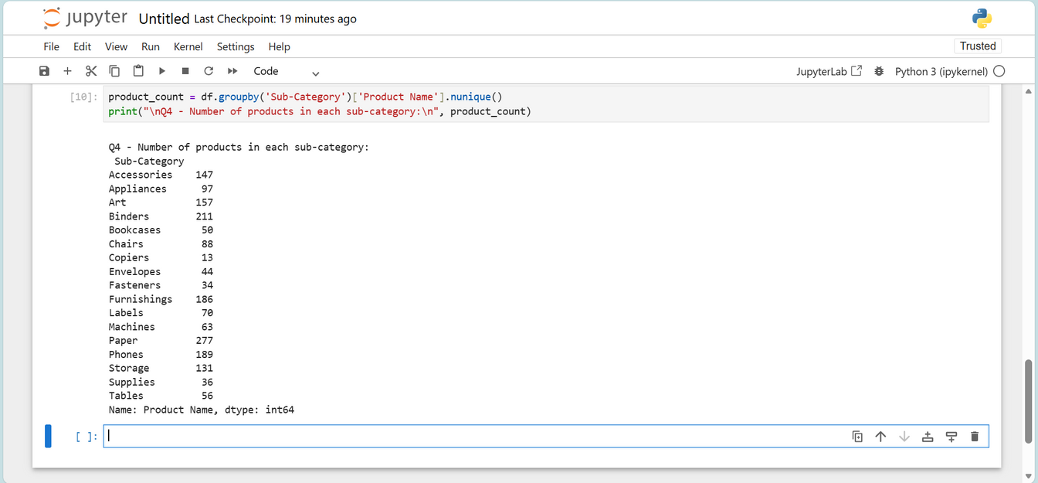
Q4- NUMBER OF PRODUCTS IN EACH SUB-CATEGORY
EXCEL ANSWER
SQL ANSWER
PYTHON ANSWER

Slide 16
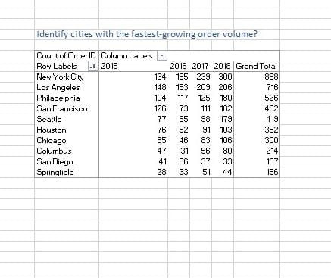
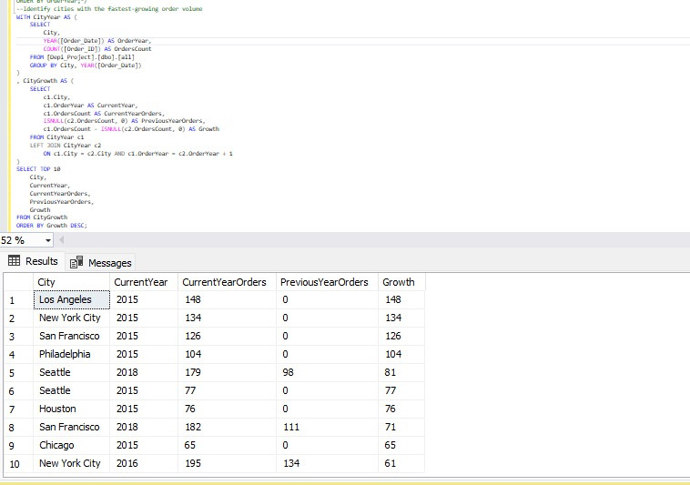
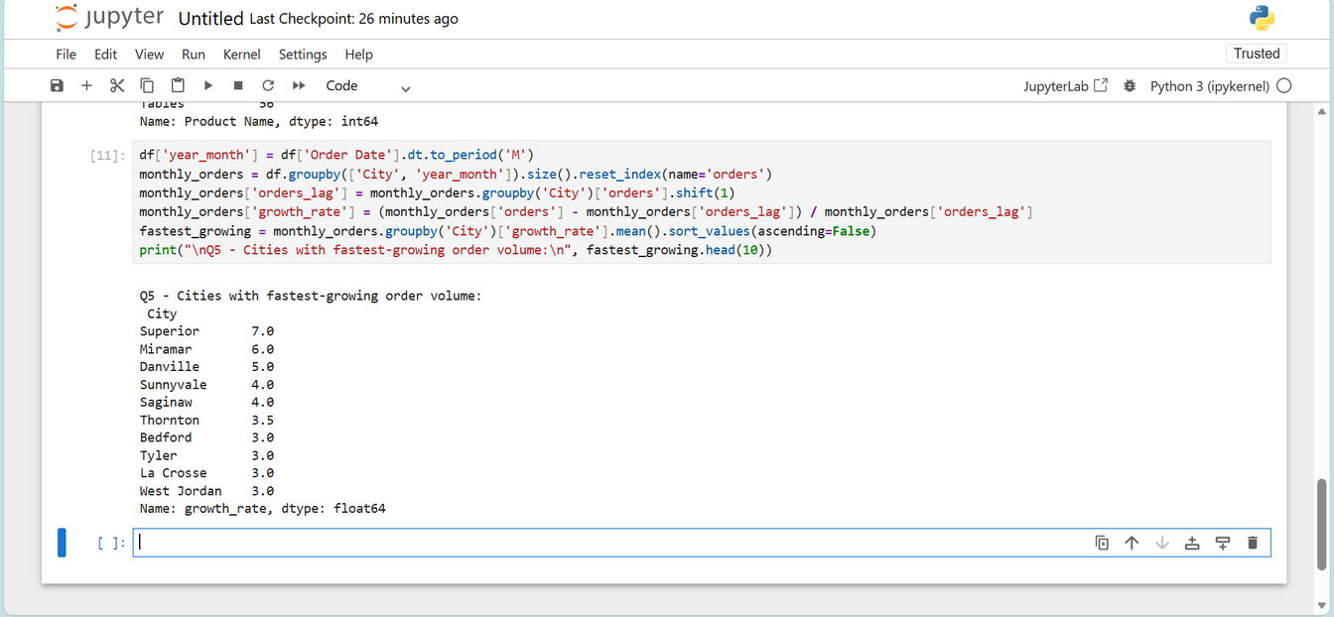
Q5- IDENTIFY CITIES WITH THE FASTEST-GROWING ORDER VOLUME
EXCEL ANSWER
SQL ANSWER
PYTHON ANSWER

Slide 17
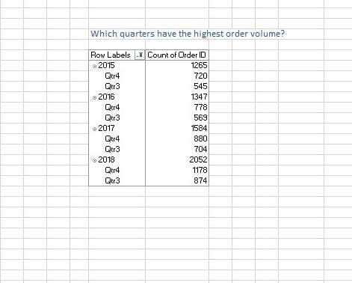
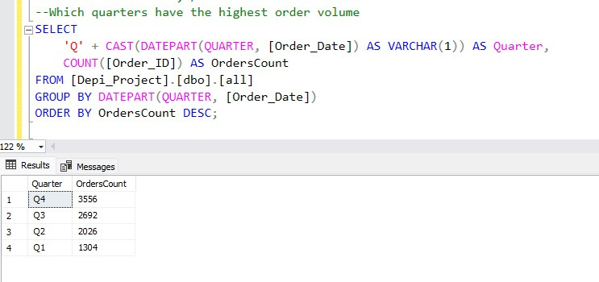
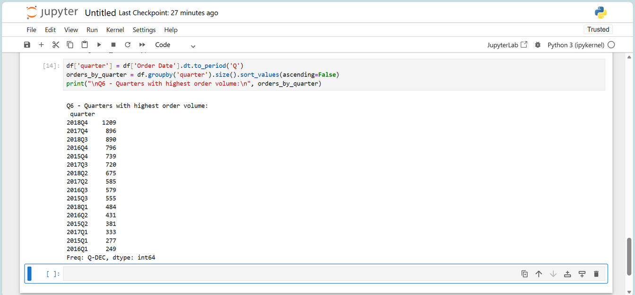
Q6- WHICH QUARTERS HAVE THE HIGHEST ORDER VOLUME
EXCEL ANSWER
SQL ANSWER
PYTHON ANSWER

Slide 18
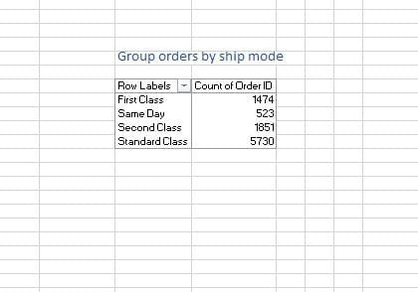
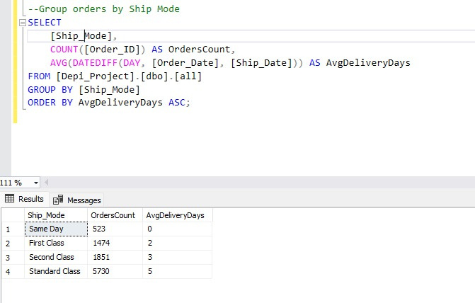
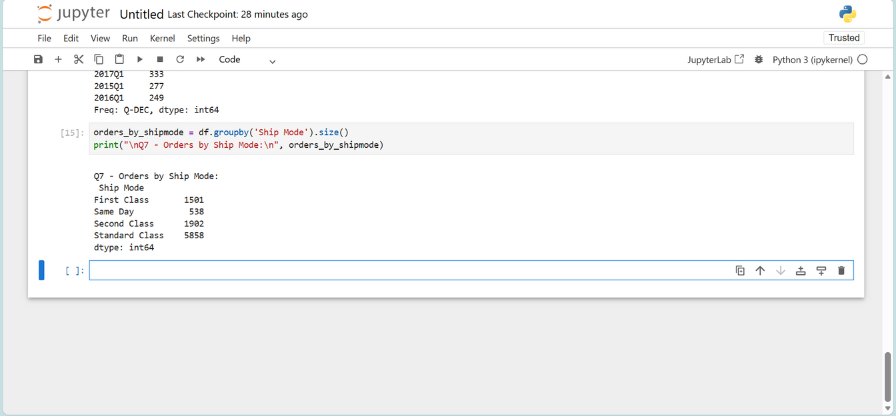
Q7- GROUP ORDERS BY SHIP MODE
EXCEL ANSWER
SQL ANSWER
PYTHON ANSWER

Slide 19
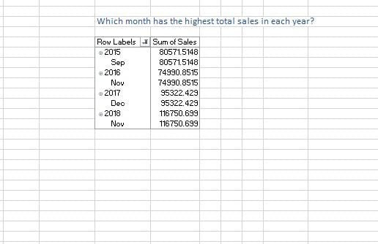
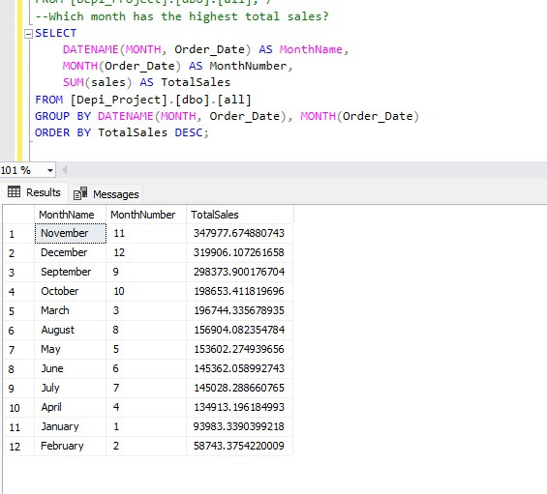
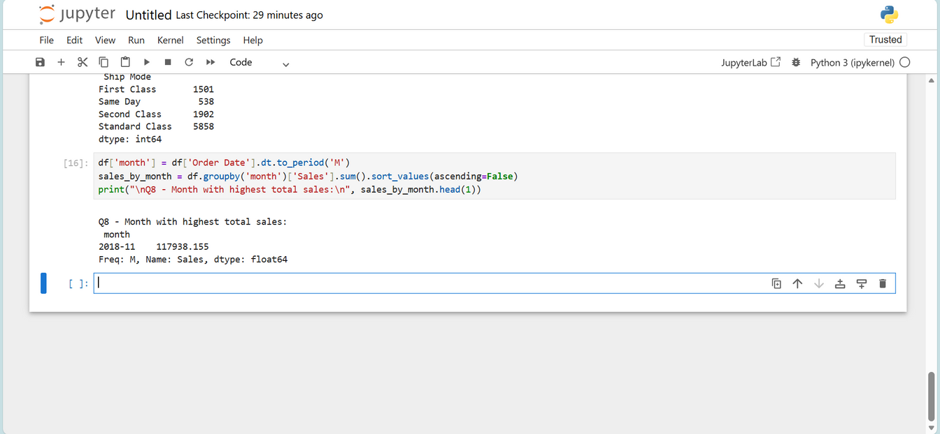
Q8- WHICH MONTH HAS THE HIGHEST TOTAL SALES
EXCEL ANSWER
SQL ANSWER
PYTHON ANSWER

Slide 20
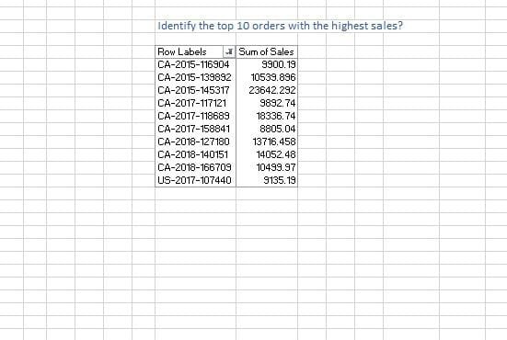
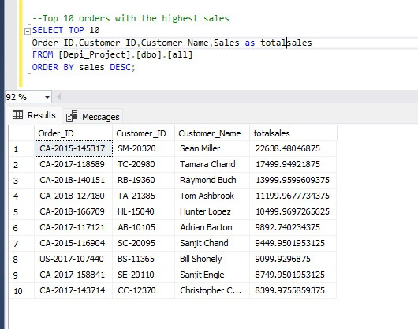
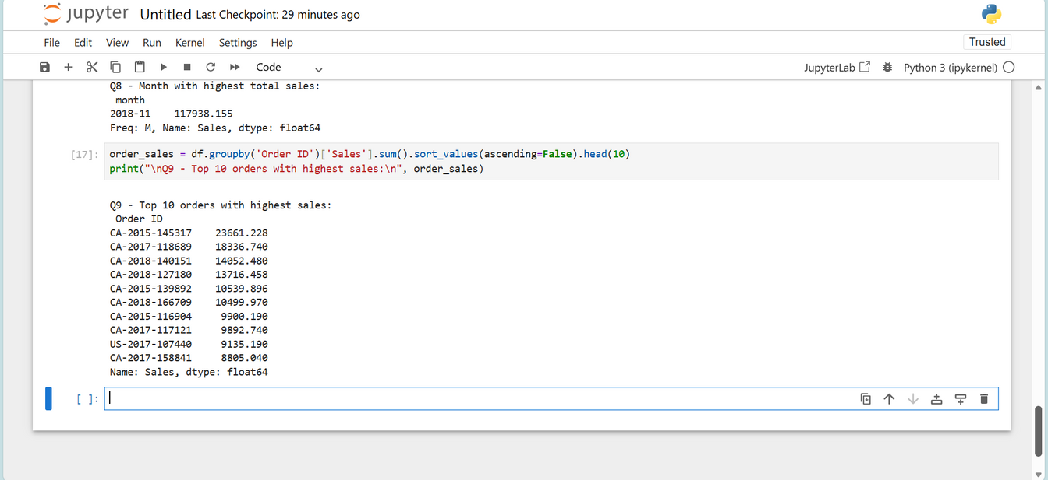
Q9- IDENTIFY THE TOP 10 ORDERS WITH THE HIGHEST SALES?
EXCEL ANSWER
SQL ANSWER
PYTHON ANSWER

Slide 21
VISUALIZATION

Slide 22
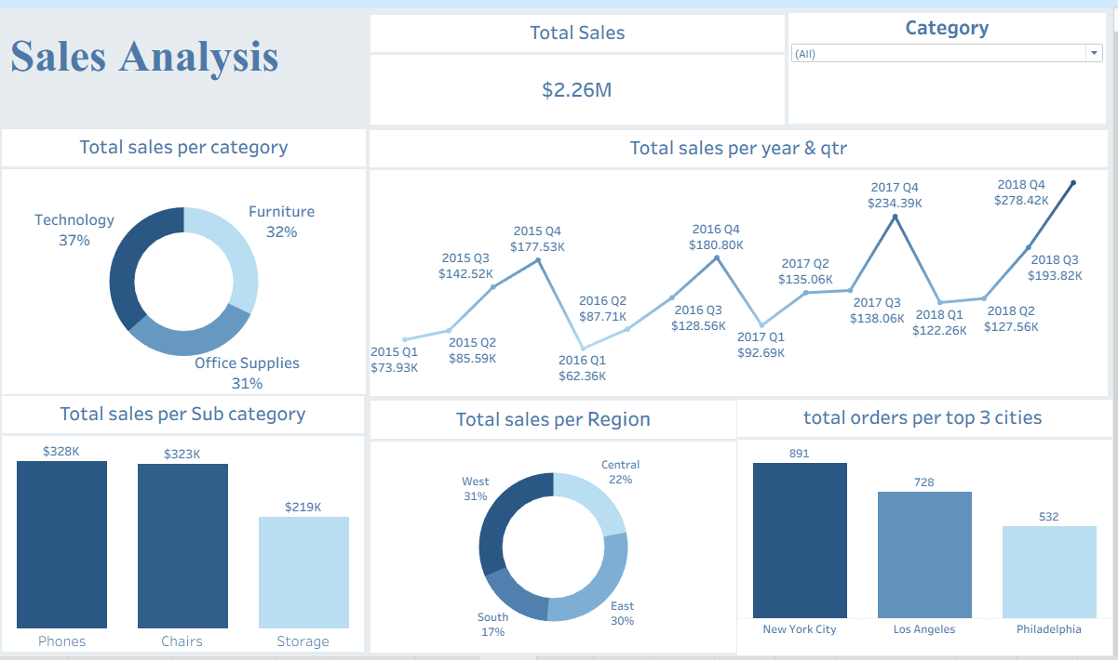
TABLEAU

Slide 23
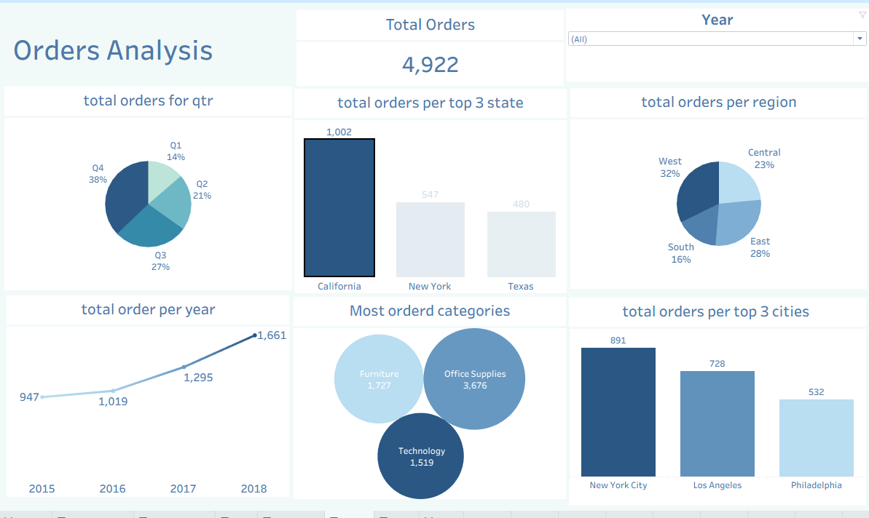
TABLEAU

Slide 24
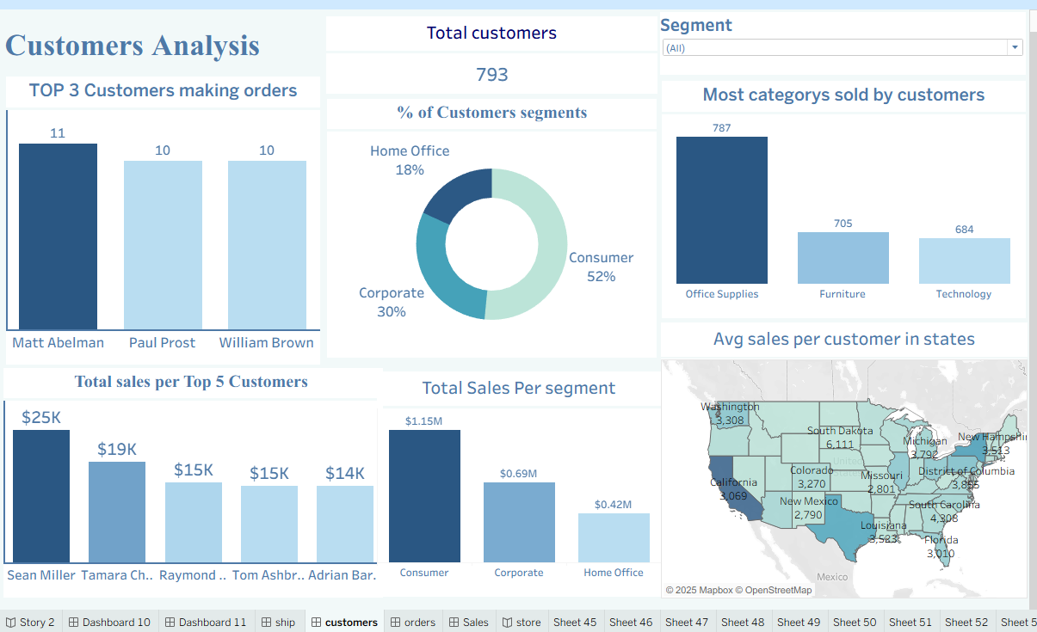
TABLEAU

Slide 25
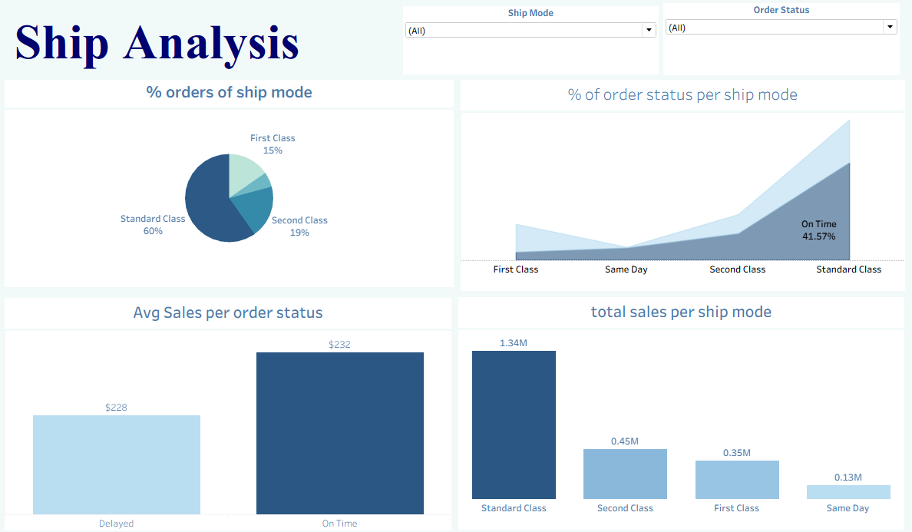
TABLEAU

Slide 26
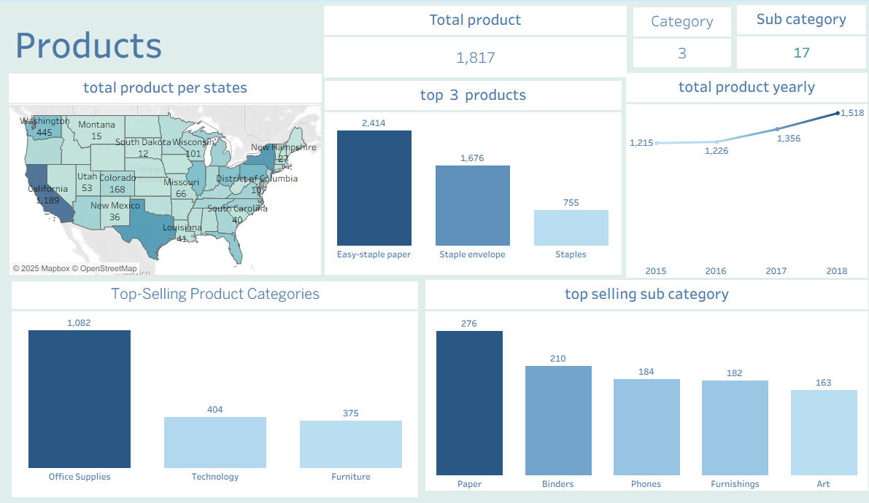
TABLEAU

Slide 27
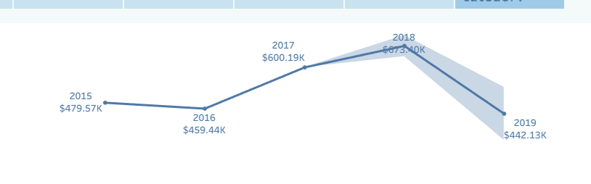
TABLEAU
FORCASTING

Slide 28

RECOMMENDATIONS

Slide 29
1. Improve Shipping Performance
Reduce delivery time for Standard Class by partnering with faster logistics providers.
Reallocate inventory to warehouses closer to high-demand regions.
Implement route optimization to reduce delays.
2. Increase Profit From the Phones Sub-Category
Expand phone product availability into international markets with emerging demand.
Introduce promotional bundles (e.g., phones + accessories) to increase average order value.
Strengthen marketing strategies for regions with growing technology adoption.

Slide 30
3. Enhance Inventory Management
Use demand forecasting models to maintain optimal stock levels.
Reduce overstock and stockouts through better replenishment scheduling.
4. Customer Insights & Segmentation
Identify high-value customer segments and offer personalized deals.
Improve customer retention programs, especially for repeat buyers of electronics.

Slide 31
5. Optimize Order Processing
Automate order validation and packaging steps to reduce handling time.
Monitor delays in the order-to-delivery pipeline and fix bottlenecks.
6. Profitability Improvement
Analyze product margins and discontinue low-profit items.
Negotiate better supplier contracts for high-volume categories like Phones.

Slide 32

CONCLUSION
After completing the cleaning and normalization steps, the dataset is now consistent, well structured, and ready for meaningful analysis. This organized model reduces redundancy, strengthens relationships, and supports faster, more accurate reporting.

Slide 33
THANK YOU
Presented by:
Abanoub Bassem Mikhael Heshamt
Yousef Ahmed ElAzab Dagher

